Slide 1
Stellar Development Foundation
Brand Guidelines 2026
01
Brand
Guidelines

Slide 2



Stellar Development Foundation
Brand Guidelines 2026
Brand logos
Typography
Color
We have adjusted these 2 logos to always include the Stellar Monogram.
Two main serif and sans-serif fonts paired for branding.
Primary
Online
RGB
HEX #
253 / 218 / 36
FDDA24
Print
PANTONE
CMYK
115 C
0 / 14 / 100 / 0
Online
RGB
HEX #
15 / /15 /15
0F0F0F
Print
PANTONE
CMYK
PROCESS BLACK C
0 / 0 / 0 / 100
Lora is used for longer headlines and subhead, also it can be used for body copy.
Lora
Online
RGB
HEX #
246 / 247 / 248
F6F7F8
Print
CMYK
0 / 0 / 0 / 0
Secondary
Online
RGB
HEX #
214 / 210 / 196
D6D2C4
Print
PANTONE
CMYK
7527 C
3 / 4 / 14 / 8
Inter is used for captions, body copy, or other detailed uses only.
Online
RGB
HEX #
183 / 172 / 232
B7ACE8
Print
PANTONE
CMYK
2645 C
24 / 29 / 0 / 0
Inter
Online
RGB
HEX #
0 / 167 / 181
00A7B5
Print
PANTONE
CMYK
7710 C
81 / 0 / 23 / 0
Download Logos
Online
RGB
HEX #
0 / 46 / 93
002E5D
Print
PANTONE
CMYK
648 C
100 / 71 / 9 / 58

Slide 3





















Stellar Development Foundation
Brand Guidelines 2026
Graphics
Highlights
fine-dotted textures, fluid gradients, and subtle noise to create a sense of depth and atmospheric movement.

Slide 4
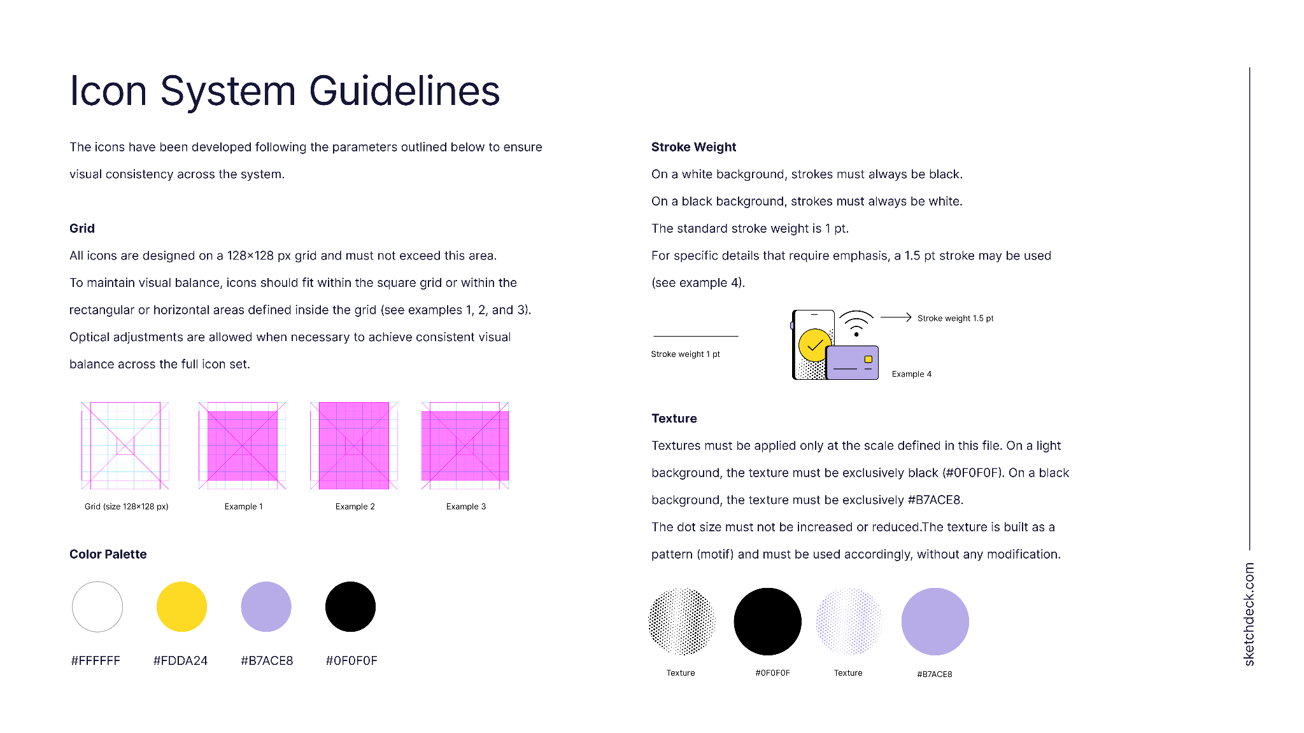
Stellar Development Foundation
Brand Guidelines 2026
Icon Guidelines

Slide 5

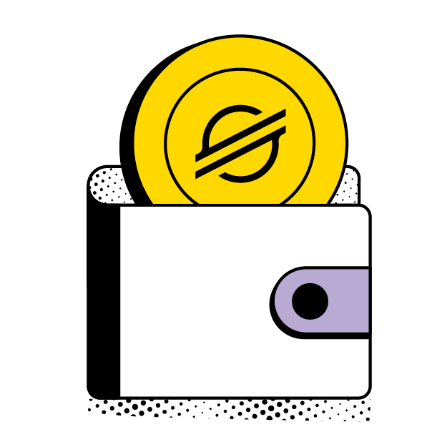













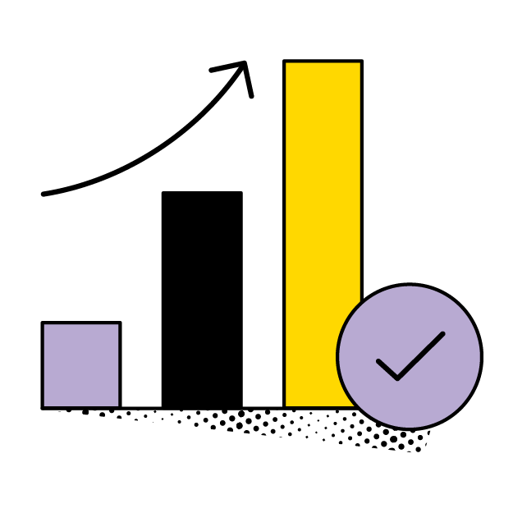












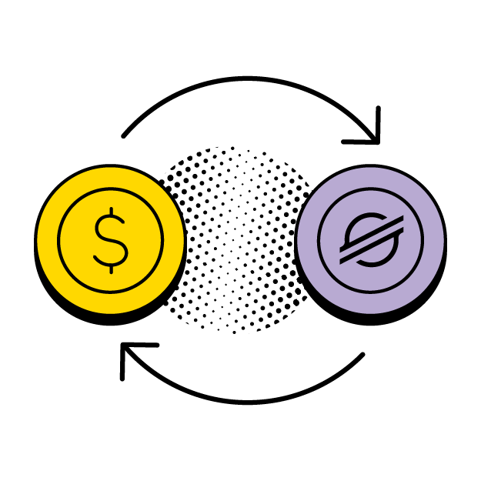








Stellar Development Foundation
Brand Guidelines 2026
Icons for light background.
All icon files linked here.

Slide 6





































Stellar Development Foundation
Brand Guidelines 2026
Icons for dark background.
All icon files linked here.

